Slide 1



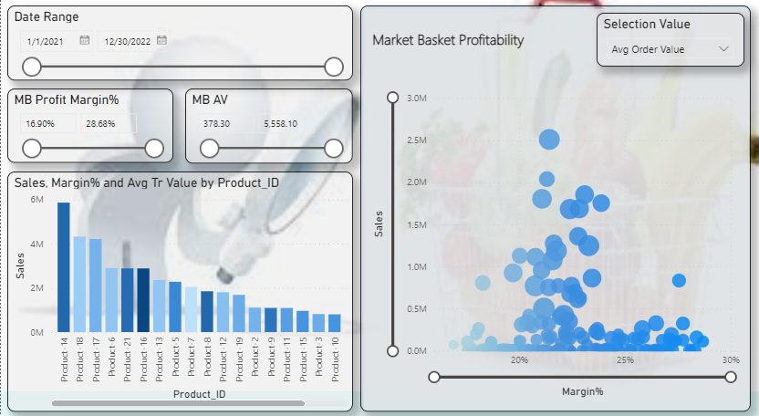
Market Basket Analysis Dashboard
Motive
Analytics Pipeline
Major Challenges
For retailer its hard to identify customer behavior towards purchasing and which inventory need to store more and manage supply chain and maintain sell as well with good ROI.
Solution
Using market basket retailer identify customer behavior of purchasing product which simultaneously bought and identify purchase pattern.
Using MBA cross selling technique help to identify which product are purchasing in pairing so its help to increase sell and ROI
Using MBA we can identify better combination of product which also help in supply chain and inventory management as well.
Marketing Tools and Platforms
Data Transformation
Business Intelligence Tools
CRM platform is used to track transaction data from customer.
Data received for historical transaction which stored in Snowflake and fetching data from there.
Some transformation done in Power BI query editor.
Power BI used here as BI tool for identify behavior of customer and getting insight for basket analysis for retailer to increase sales even help in supply chain as well.
Dashboard Sample and Use Case
Dashboard
Benefits
This analysis helps understand the products that go together with the products that form the cornerstones of the product line.
Its Help in optimizing inventory by determining the popularity of products in a store.
It helps of discovering new marketing strategies to grow a brand. It analyzes demographic and gentrification data to help you make informed decisions about where to open your next store or place ads.
This dashboard Help to identify which basket are much more prefer by customer based on there previous transaction based on repetition and Avg order value.
Product level performance value and margin we can identify which help to identify which inventory need to store and which product give good sales and profitability in which buckets.
Using cross selling matrix identify product support, confidence, lift based on likelihood purchase together which increase sales and ROI.
* Estimated

